Slide 1
DATA SCIENCE PROBLEM STATEMENT No. 50

Slide 2
BASIC CSV FILE ANALYZER

Slide 3
CONTENT
Problem Statement
Why this ?
Use of Modules
Use of Error Handling
Use of try method
Data Cleaning and Saving it

Slide 4

PROBLEM STATEMENT
To design Python script that reads a CSV file and gives quick insights.
Expected Outcome:
Show file structure (columns, types),
Show top 5 and bottom 5 rows,
Count of unique values per column,
Save cleaned data to a new CSV
Input:
Any CSV file

Slide 5
WHY THIS ?
The reason I chose this problem statement was because it stood out to me more as compared to other problems. In my opinion CSV analyzer solve
issues of many who want a quick insight to their CSV file.

Slide 6
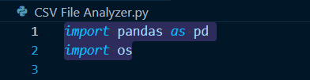
USE OF Modules
During the course of learning about Data Science on GUVI, I learned about the concept of importing required modules and thus applied appropriate modules in my python script.

Slide 7
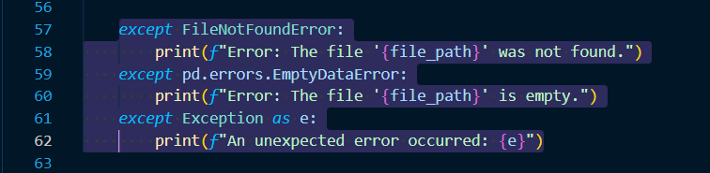
USE OF ERROR HANDLING
During the course of learning about Data Science on GUVI, I learned about the concept of error handling and thus thought of applying in my python script.

Slide 8
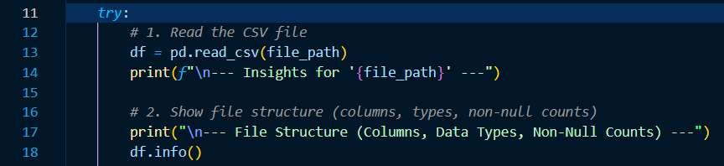
USE OF try method
During the course of learning about Data Science on GUVI, I learned about the concept of try method and thus thought of applying in my python script.

Slide 9
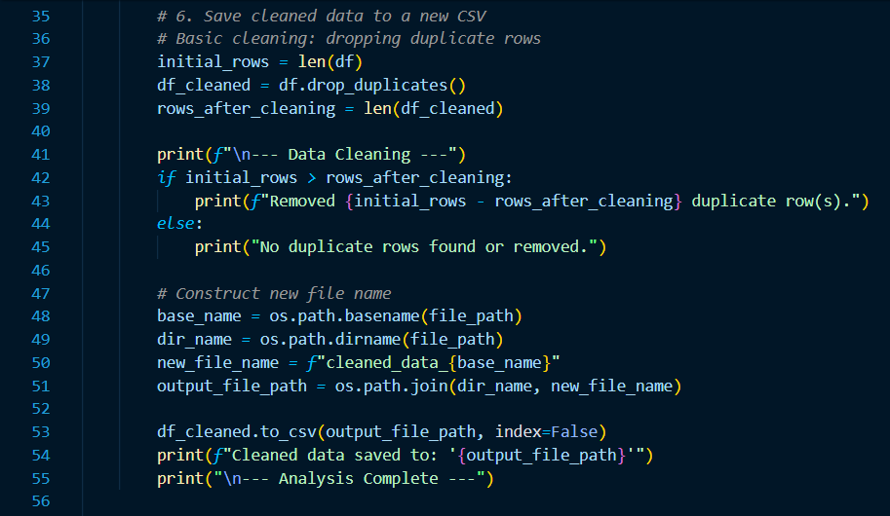
DATA CLEANING AND SAVING IT
With GUVI videos and external help, I was able to complete a major part where I got stuck a few times and that was saving the cleaned file.
Scratched my head and got angry but got over with it within the time period. Since this was a part of marking rubric I paid more attention to it, similarly I tried sticking to the rubric as much as possible for other parts also.

Slide 10
Thank you
From: Nisarg Kumar Gharde
*I hope the presentation was up to your expectation and sorry for any inconvenience, if caused.

